Slide 1
Sections of Solids
ME 111
Engineering Drawing

Slide 2
Sectional Views
The internal hidden details of the object are shown in orthographic views by dashed lines.
The intensity of dashed lines in orthographic views depends on the complexity of internal structure of the object.
If there are many hidden lines, it is difficult to visualize the shape of the object
unnecessarily complicated and confusing.
Therefore, the general practice is to draw sectional views for complex objects in addition to or instead of simple orthographic views.
A sectional view, as the name suggests, is obtained by taking the section of the object along a particular plane. An imaginary cutting plane is used to obtain the section of the object.

Slide 3
Theory of Sectioning
Whenever a section plane cuts a solid, it intersects (and or coincides with) the edges of the solids.
The point at which the section plane intersects an edge of the solid is called the point of intersection (POI).
In case of the solids having a curved surface, viz., cylinder, cone and sphere, POIs are located between the cutting plane and the lateral lines.

Slide 4
True Shape of Sections
A section will show its true shape when viewed in normal direction.
To find the true shape of a section, it must be projected on a plane parallel to the section plane.
For polyhedra, the true shape of the section depends on the number of POIs. The shape of the section will be a polygon of the sides equal to the number of POIs.
The true shape of the section of a sphere is always a circle.
The sections of prisms and pyramids are straight line segmented curves.
The sections of cylinders and cones will mostly have smooth curves.

Slide 5
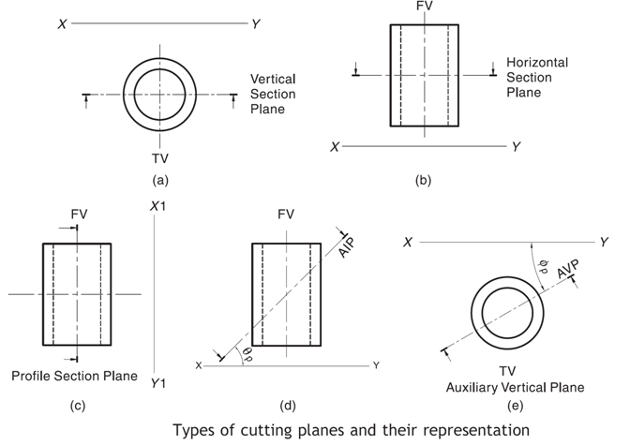
Types of Cutting Planes and Their Representation
A cutting plane is represented by a cutting plane line
The cutting plane line indicates the line view of the cutting plane.
The two ends of the cutting plane line are made slightly thicker and provided with arrows.
The direction of the arrow indicates the direction of viewing of the object.
In the first-angle method of projection, the direction of the arrows is toward the POP, i.e., toward XY (or X1Y1).
Types of section planes
Vertical Section plane
Horizontal Section Plane
Profile Section plane
Auxiliary Section plane
Oblique Section plane

Slide 6
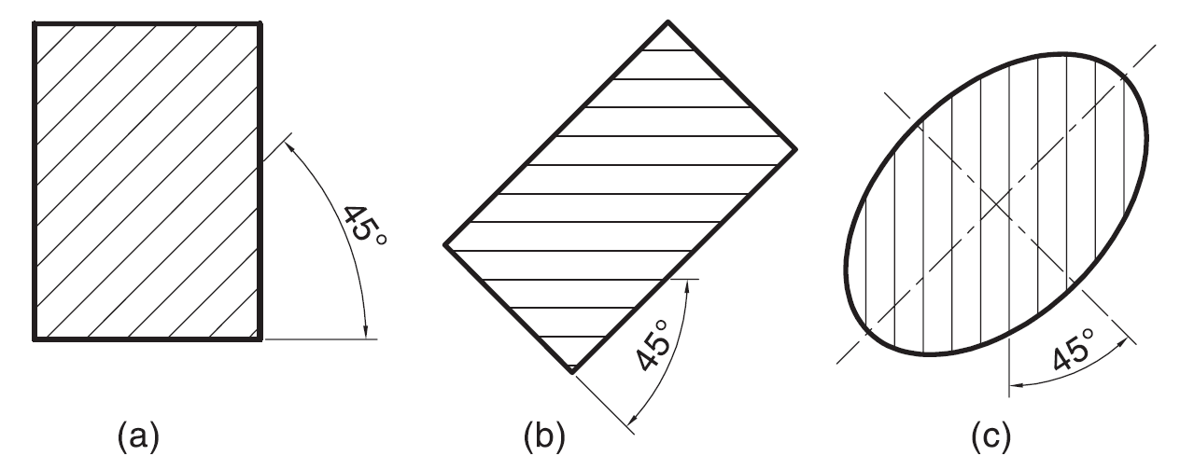
Hatching of the Sections
The surface created by cutting the object by a section plane is called as section.
The section is indicated by drawing the hatching lines (section lines) within the sectioned area.
The hatching lines are drawn at 45° to the principal outlines or the lines of symmetry of the section
The spacing between hatching lines should be uniform and in proportion to the size of the section.
2H
H or
HB

Slide 7
Section plane parallel to one of the Reference Planes

Slide 8
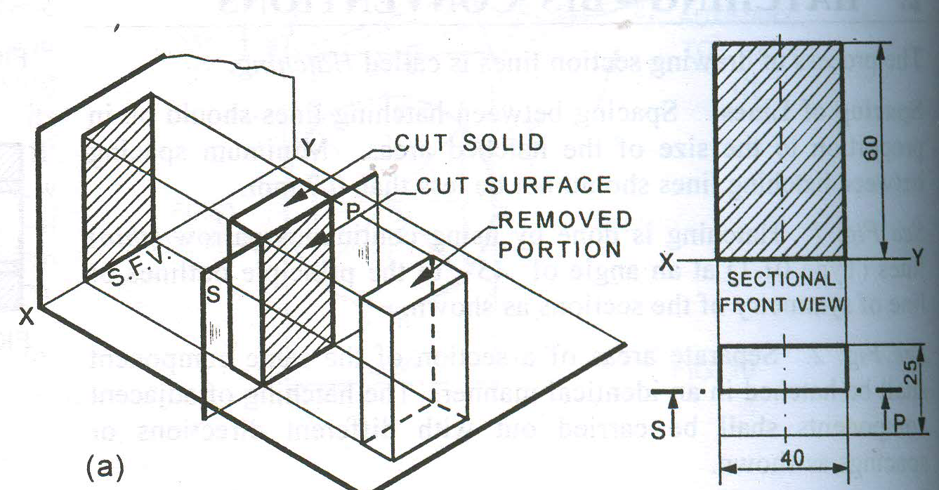
Remember:-
After launching a section plane either in FV or TV, the part towards observer is assumed to be removed.
As far as possible the smaller part is assumed to be removed.

Slide 9
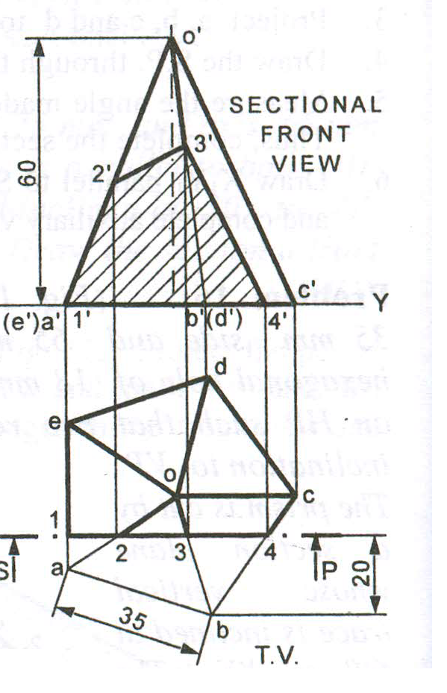
Pentagonal pyramid resting on HP with on of its edge perpendicular to VP
A vertical sectional place cuts the solid 20 mm away from the farthest corner of solid from XY reference line.
o’
3’
2’
1’
a’(e’)
b’(d’)
4’
c’
d
e
o
c
a
b

Slide 10
A cone of diameter 60 mm and height 60 mm is resting on HP on one of its generators. A section plane is parallel to HP and 15 mm above HP, cuts the solid removing the top portion. Draw the front view and sectional top view of the solid.
O’
O’
60
f’
g’
d’
e’
c’
b’
a’
X
1’
2’, 8’
3’, 7’
4’, 6’
5’
15
Y
7
7₁
8
6₁
f
8₁
6
3’, 7’
1’
2’, 8’
d
4’, 6’
5’
c
O
1₁
a
1
5
5₁
O₁
b
2₁
e
Φ60
2
4
4₁
g
3
3₁
Assume cone is resting on HP
Tilt cone about its corner

Slide 11
Section plane inclined to one of the Reference Planes

Slide 12
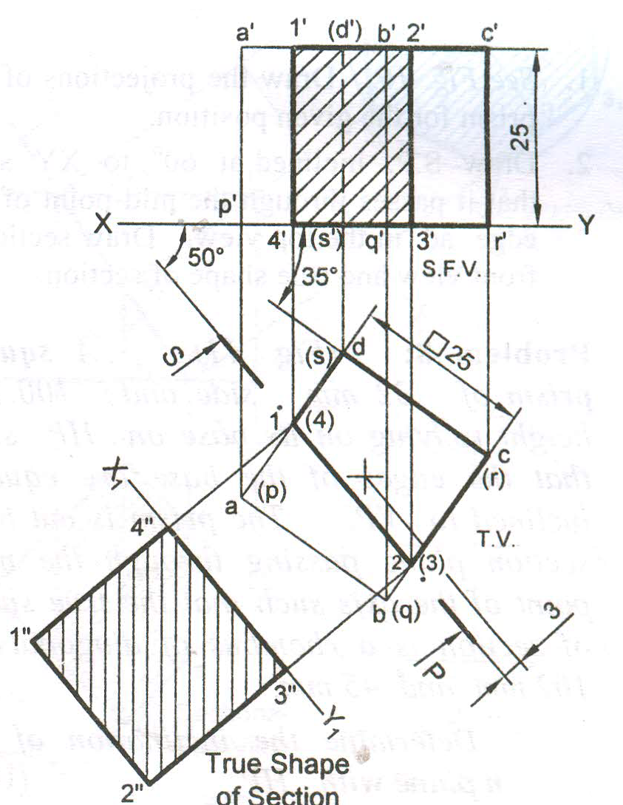
1. Square prism resting on HP with one of its edges making 35º to VP
2. Section plane perpendicular to HP cuts the solid 3 mm away from the axis of solid and is inclined at 50º to VP.
a’
1’
d’
b’
2’
c’
p’
s’
q’
r’
35º
4’
3’
50º
d(s)
1(4)
a(p)
c(r)
2(3)
b(q)

Slide 13
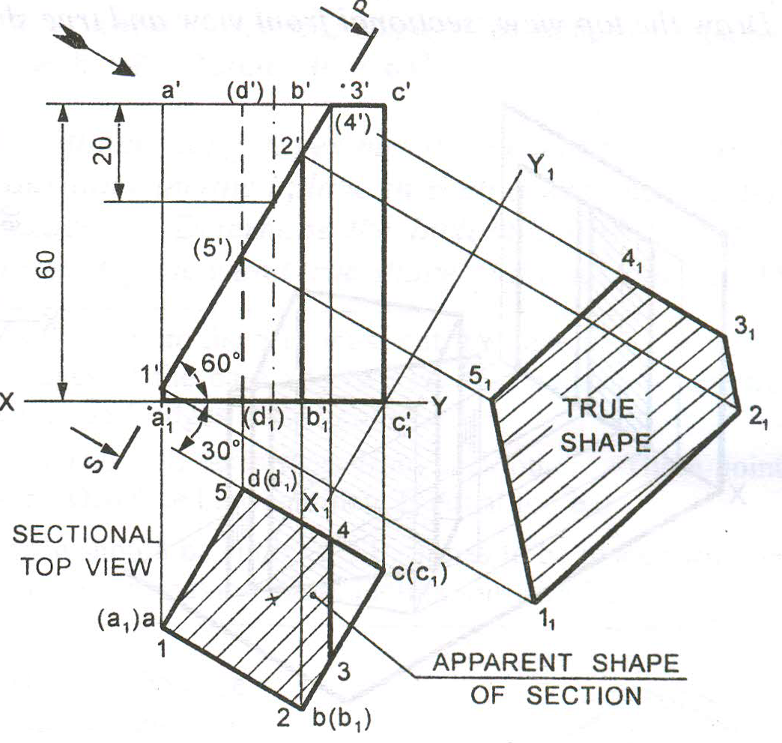
Square prism resting on HP with one of its edges inclining 30º to VP
A section plane is inclined 60º to HP and perpendicular to VP passing through the axis at 20 mm below the top face cuts it .
a’
d’
b’
c’
20
d(s)
5
1
c(r)
a(p)
4
2
3
b(q)

Slide 14
A Cone base 75 mm diameter and axis 80 mm long is resting on its base on H.P. It is cut by a section plane perpendicular to the V.P., inclined at 45º to the H.P. and cutting the axis at a point 35 mm from the apex. Draw the front view, sectional top view, sectional side view and true shape of the section.
X₁
i₁
h₁
g₁
k₁
j₁
f₁
e₁
o’
o”
l₁
d₁
c₁
35
g”
g’
f”
h”
a₁
f’
e’
i”
b₁
h’
e”
i’
d’
d”
j”
c’
j’
k’
c”
k”
b’
b”
l”
a’
l’
a”
X
2 12
3 11
4 10
5 9
6 8
Y
7
10”
1
4”
5”
6”
7”
8”
9”
3”
2”
1”
12”
11”
4
3
5
2
c
d
6
b
e
o
f
1
a
g
7
h
12
l
j
i
8
k
11
9
Y₁
10

Slide 15
Comparison between section views when the section plane is parallel and inclined to one of the Reference Planes

Slide 16
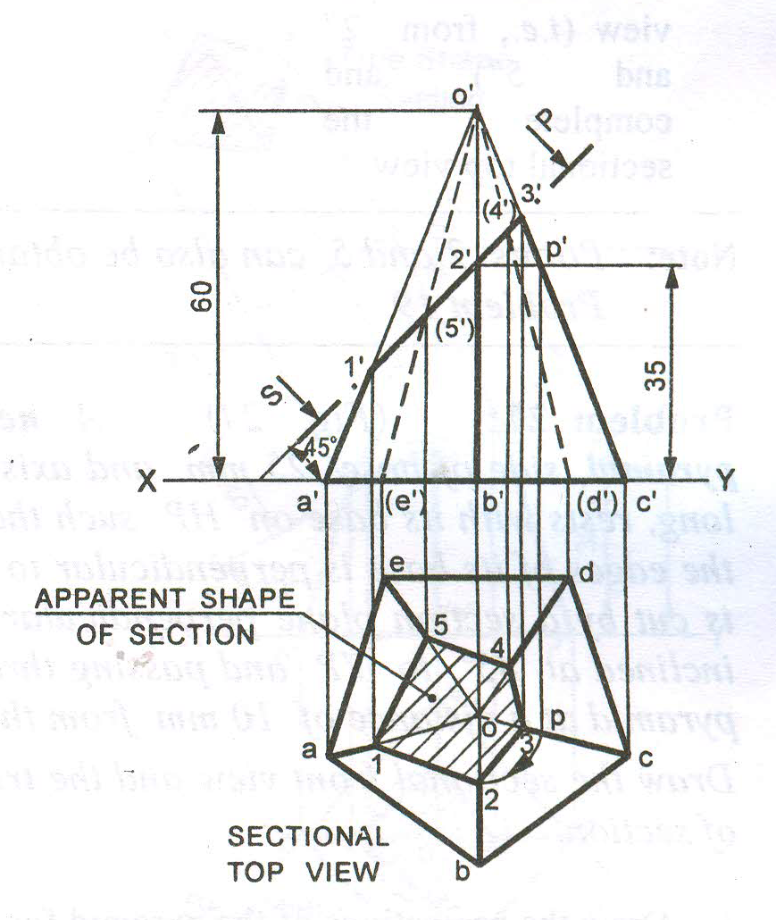
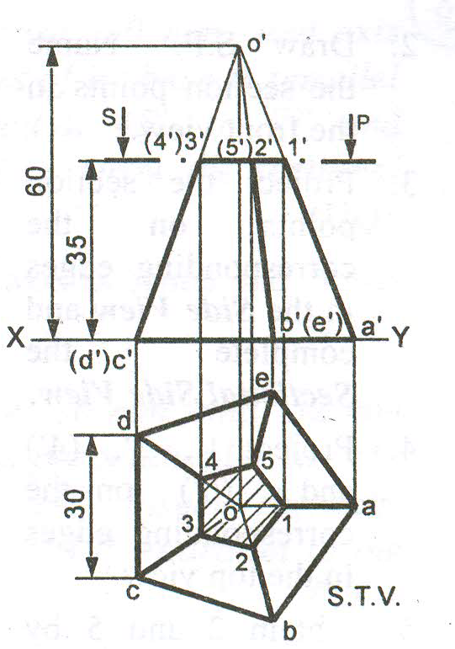
Horizontal sectional plane
Inclined sectional plane

